Slide 1
Uncover Your Impact: Organizing and Collecting Hidden Data to Tell Your Work Story
02.14.25
SBU ❤️ Love Data Week 25
Julie Sharma
Stony Brook University, Division of Information Technology

Slide 2
What Did You Do This Year?
🤔 trying. to. remember….

Slide 3
Let Me Tell You What I Did
Project: Love Data Week Workshop
Spent 20 hours
Got comments like “This will save me so much time.”
. . .
😎 Knowing

Slide 4
Objectives
You will be able to
Tag and categorize emails to easily find key information when you need it
Code your calendar events to quantify your time allocation and identify hidden patterns in your workload
Track project time using a custom spreadsheet to visualize your progress and demonstrate your impact

Slide 5
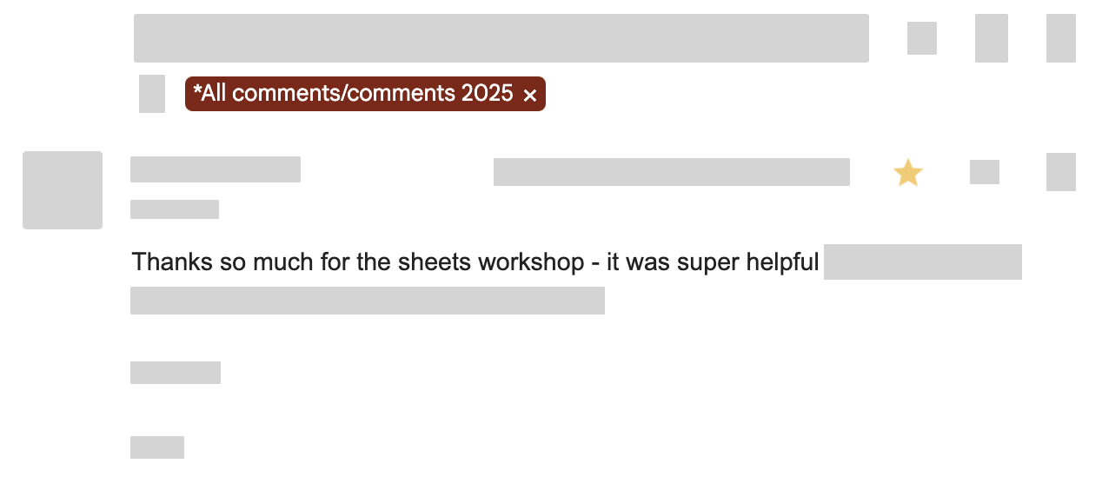
1. Tag And Categorize Emails
Make it easy to find comments, accomplishments, project work, etc. sent to you via email

Slide 6
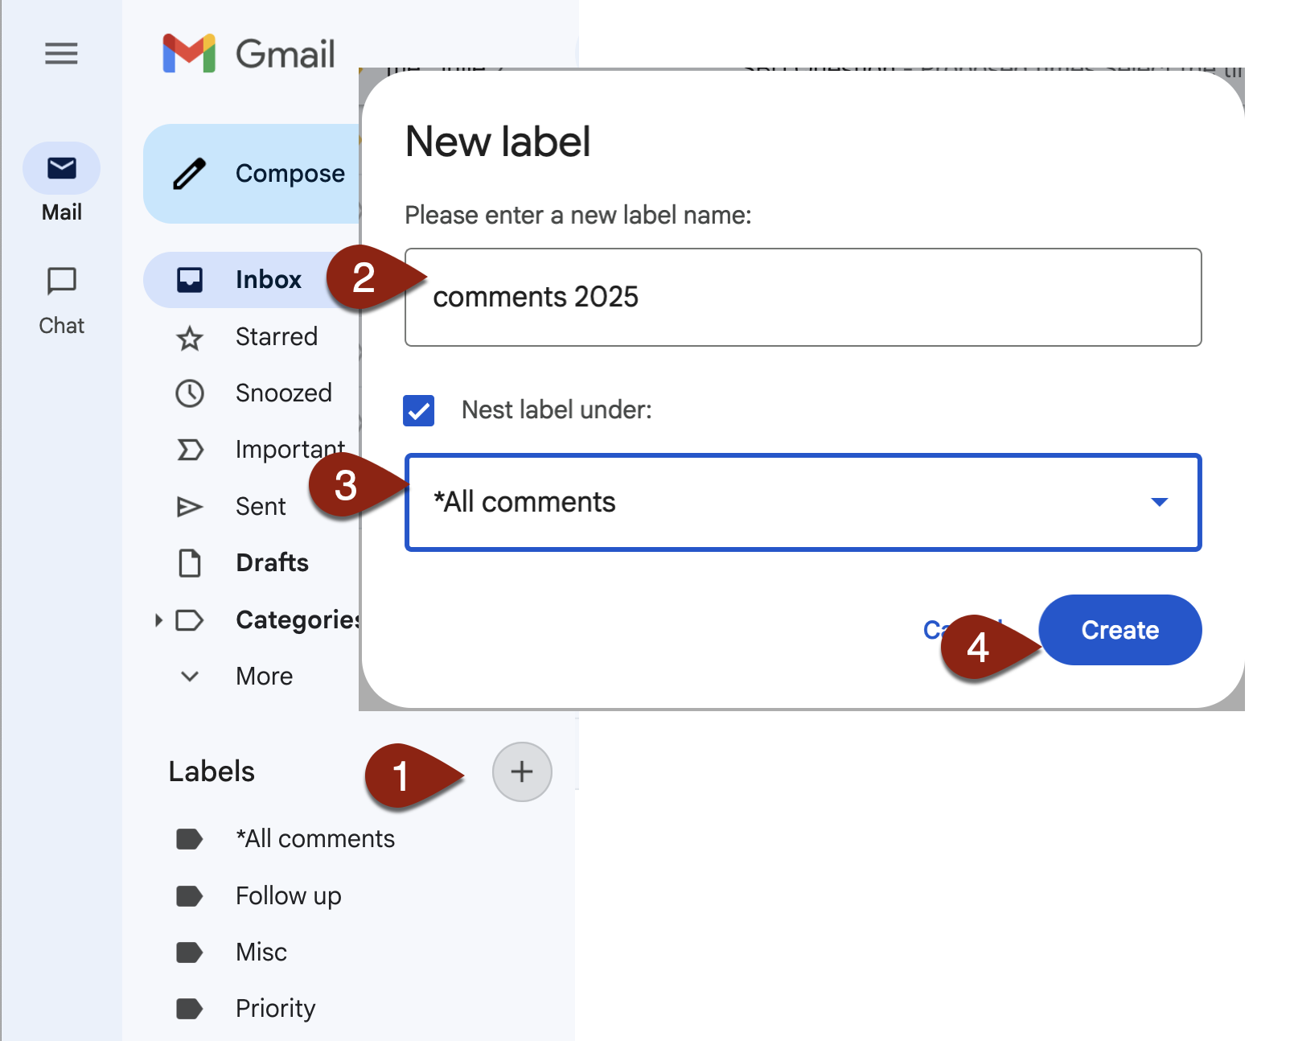
1. Tag and Categorize Emails: Create Label
Create a label
In Gmail, on the left side next to Labels, click +
Give the label a name (e.g., comments 2025)
optional: Choose another existing label to nest it under (e.g., All comments)
Click Create
Tip: You can also manage and create labels in Settings > Labels at mail.google.com/mail/u/0/#settings/labels

Slide 7
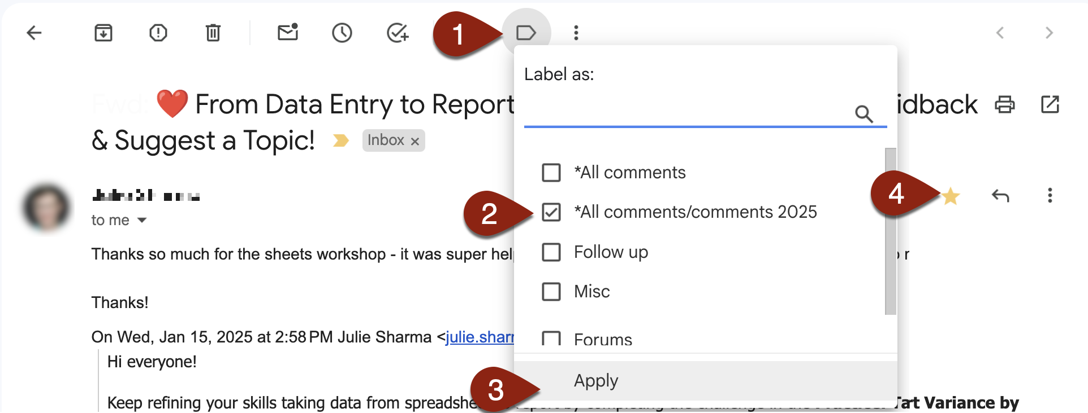
1. Tag and Categorize Emails: Label Email
Tag/Label Email
While in an email you want to tag, click the label icon near the top center
Select the label you created optional: select additional labels as needed
Click Apply
Tip: Also click the ⭐️ to star the email, making easier to find later (especially if there are several emails in the conversation)

Slide 8
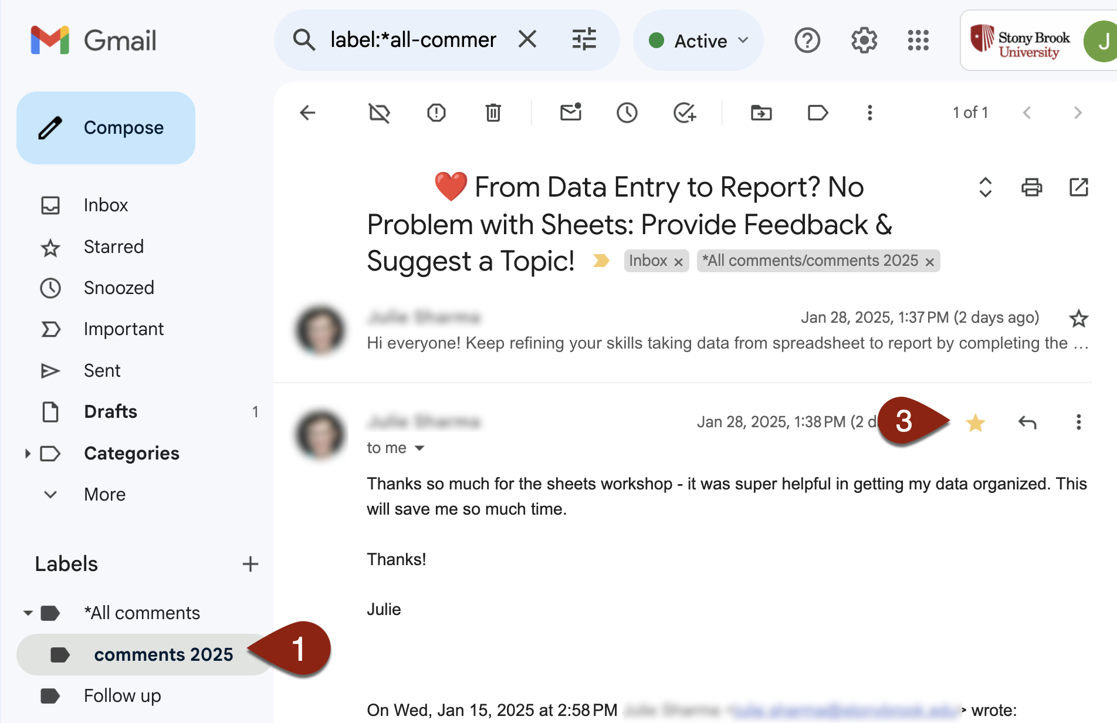
1. Tag and Categorize Emails: Find Labeled Emails
Find Labeled Emails
Select the label from the list on the left
Click on an conversation
If you starred a message in the conversation, it will open directly to the starred message
Copy out relevant text

Slide 9
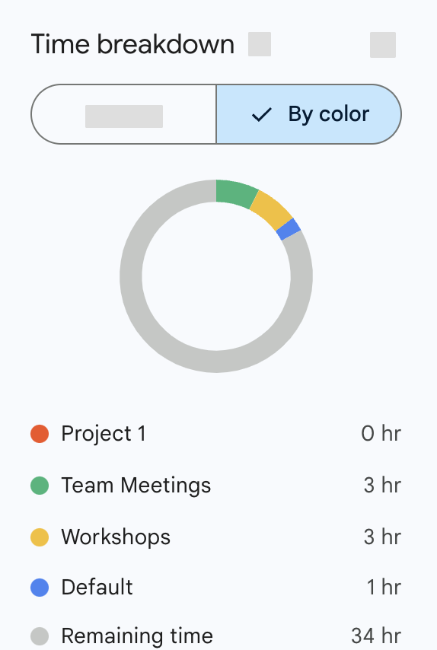
2. Code Your Calendar Events
Make it easy to quantify your time and find patterns in your workload from events on calendar

Slide 10
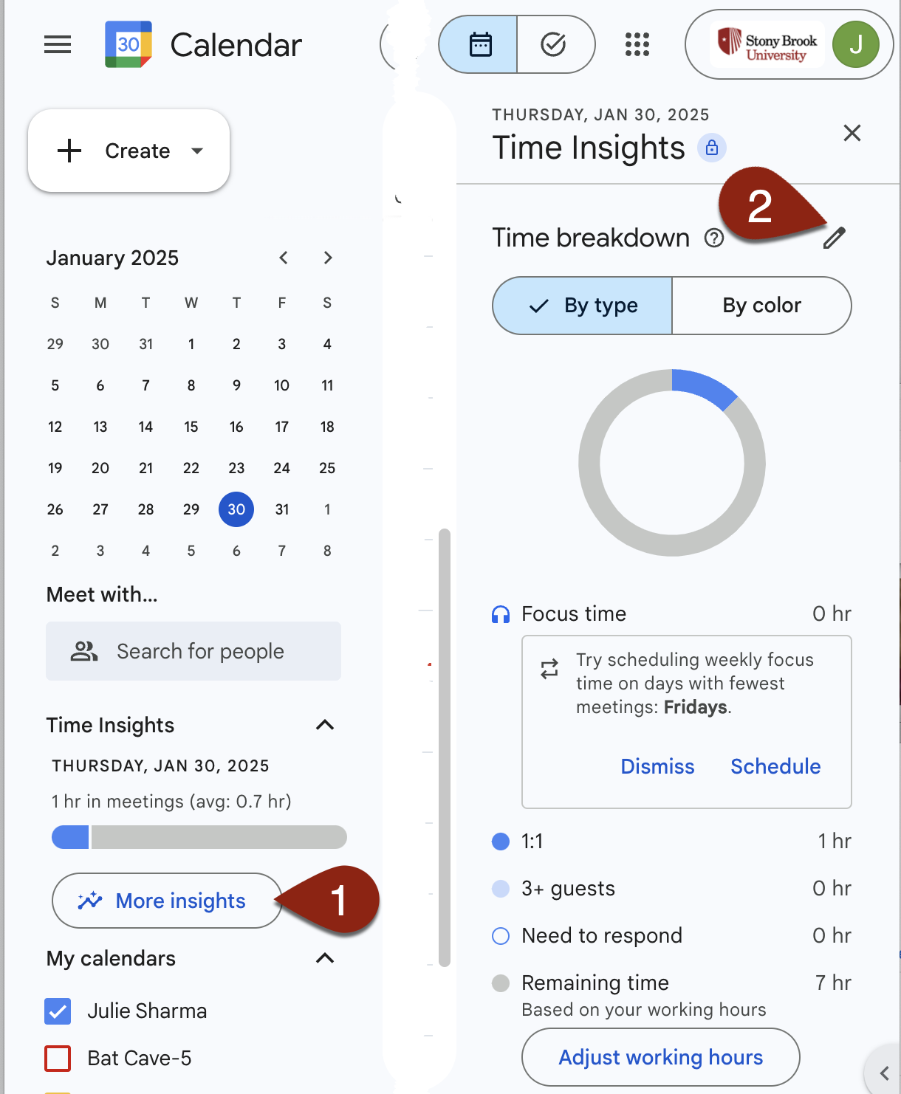
2. Code Your Calendar Events: Access Labels
Access Time Insights Labels
In Calendar, in the left sidebar click to open Time Insights and click More insights Tip: If you don’t see Time Insights on the left, click the ≡ icon in the top left corner
Time Insights opens in the right sidebar. Near the top next to Time breakdown, click the pencil

Slide 11
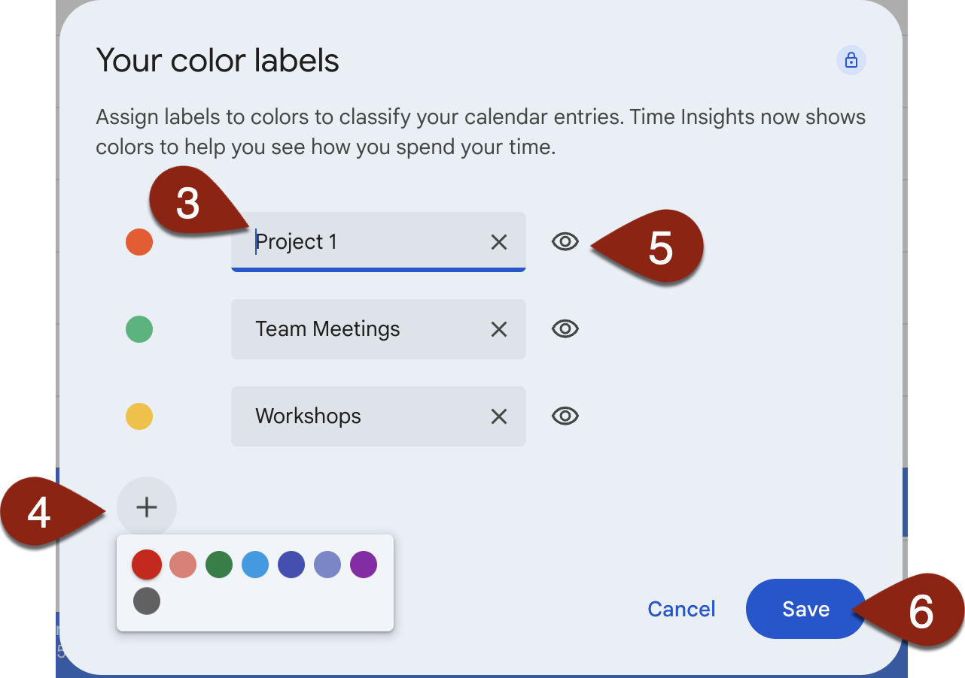
2. Code Your Calendar Events: Add/Edit Labels
Add/Edit Labels
In Your color labels, edit existing labels’ names by clicking a name and editing it or click x to remove a label’s name
To add new labels, click + and then select a color and type a name
To hide a label in Time insights, click the eye icon
Click Save

Slide 12
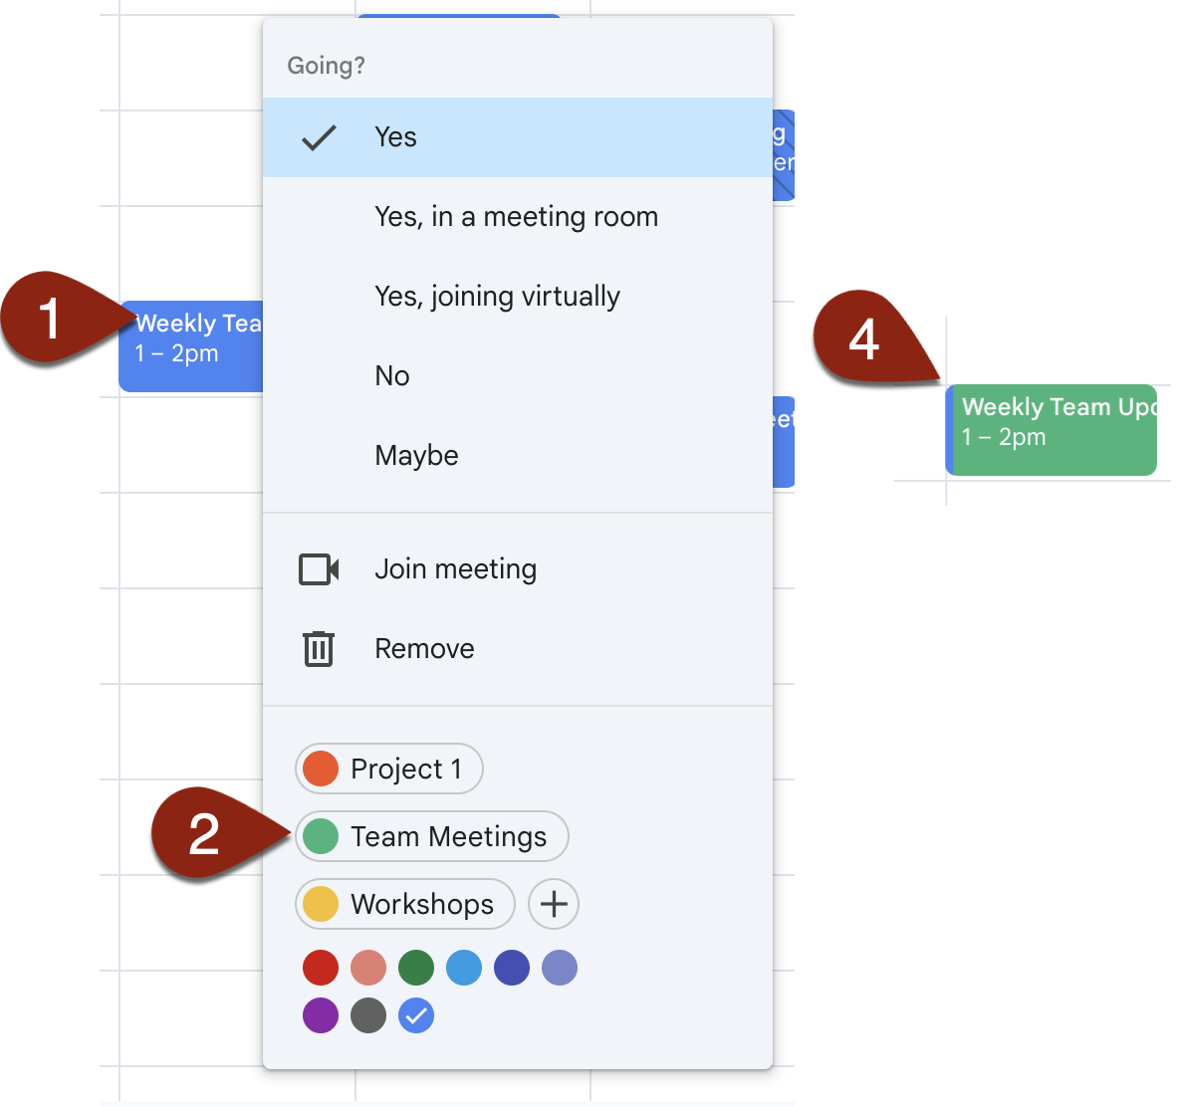
2. Code Your Calendar Events: Apply Label To Event
Apply Label to Event
Existing event: In calendar, right-click on the event
At the bottom of the window, select a label to apply it (or create a new one by clicking +)
If it’s a recurring event, select whether to apply to This event or All events and click OK
The event changes to label’s color but keeps a small bar of the calendar’s main color on the event’s left side

Slide 13
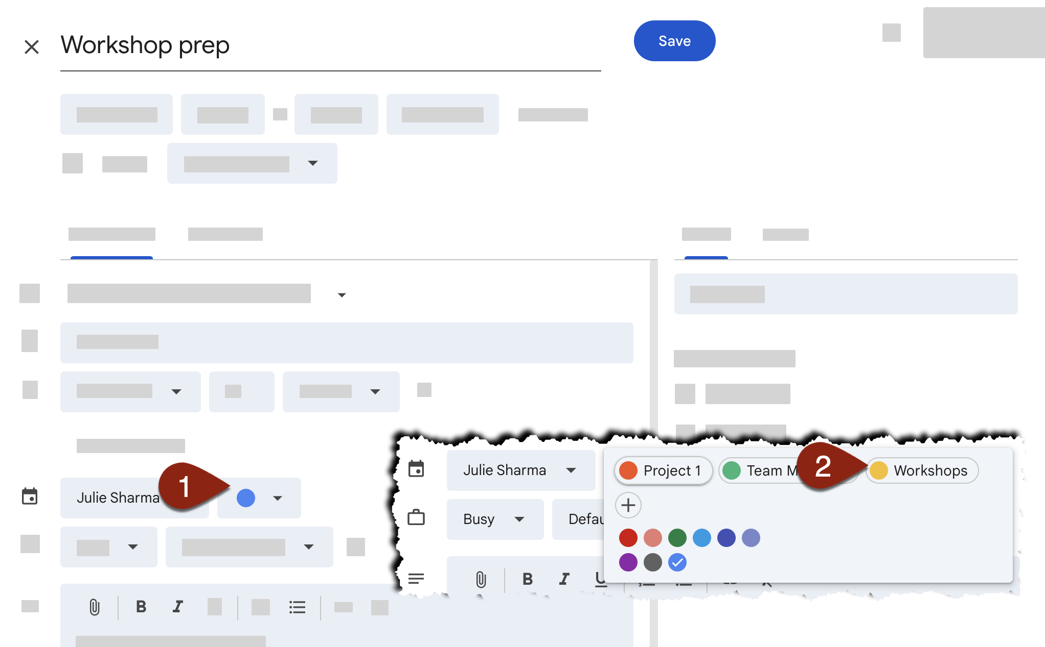
2. Code Your Calendar Events: Apply Label in Edit View
Apply Label to Event When Editing It
In edit view for an event you’re creating or editing, in the Calendar section, click Select event color
Choose an existing label (e.g., 🟡 Workshops) or click + to add a new label

Slide 14
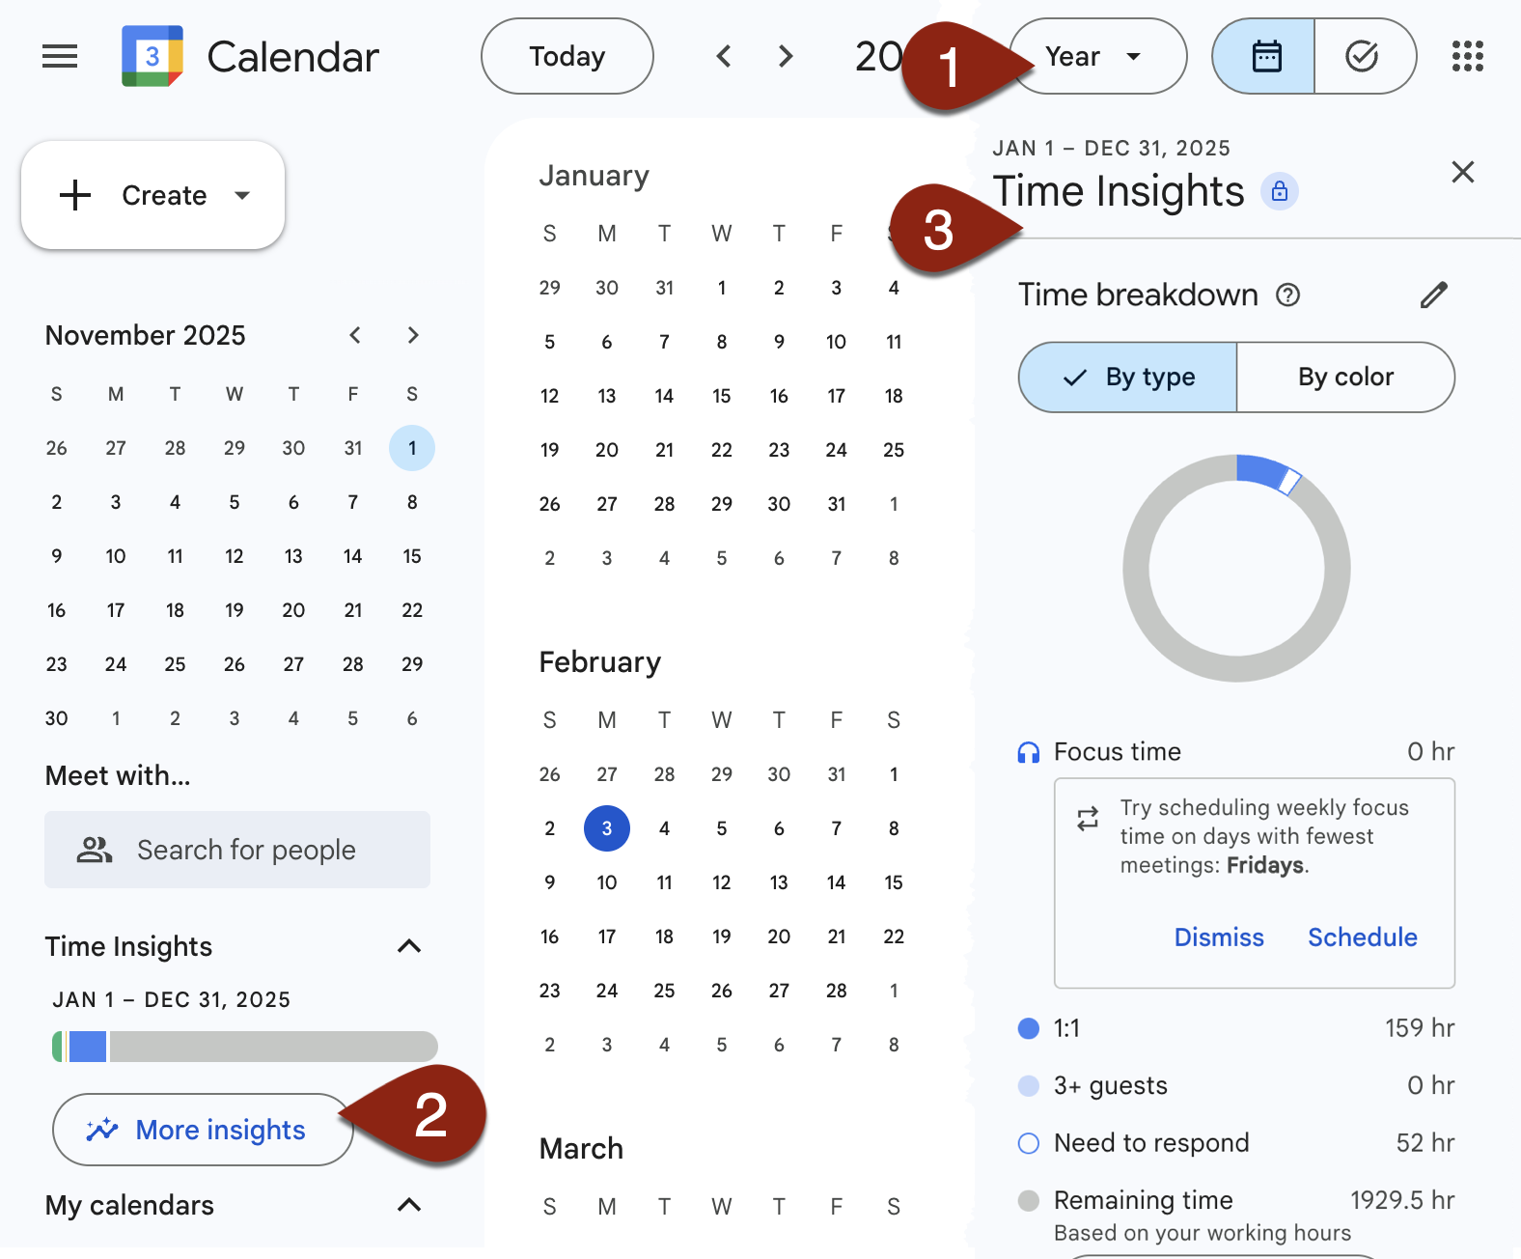
2. Code Your Calendar Events: Access Time Insights
View Time Insights for a Period of Time
In the drop down near the top right, select the time period (e.g., Week, Month, Year) Tip: Change the dates you see insights for by clicking on the mini calendar near the top left
Open Time Insights by clicking Time Insights and More insights on the left
Time Insights opens on the right

Slide 15
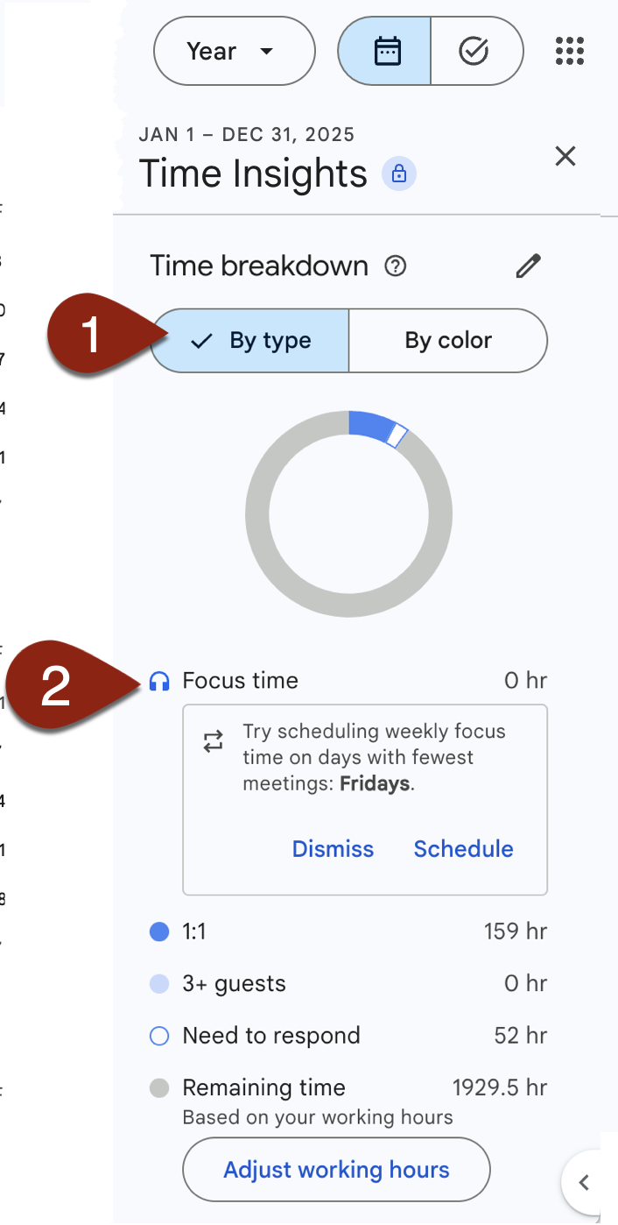
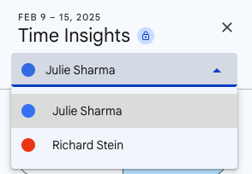
2. Code Your Calendar Events: Analyze Time Insights by Type
By Type
Near the top of Time Insights, click By type
See time breakdown by event type:
Focus time
1:1
3+ guests
Need to respond
Remaining time
Tip: If you have access to manage someone else’s calendar, you’ll see a dropdown to select whose calendar’s Time Insights to view

Slide 16
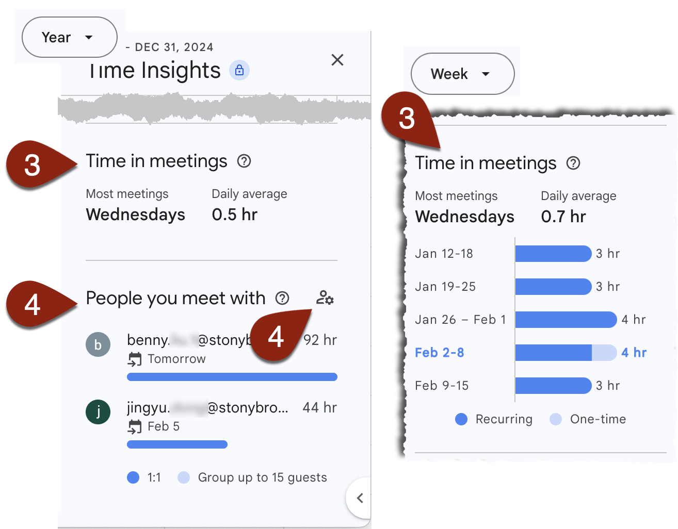
2. Code Your Calendar Events: Analyze Time Insights by Type - continued
By Type …continued
Scroll down to Time in meetings for average time in meetings* Tip: Time in meetings information varies based on time period; change to Week, Month, etc. for different insights *Meetings have another guest(s), you RSVP’d Yes, mark you busy and < 8hr.
Scroll down to People you meet with to see who you meet with most (1:1 or in larger groups) Tip: Manage pinned people to always see time for specific people

Slide 17
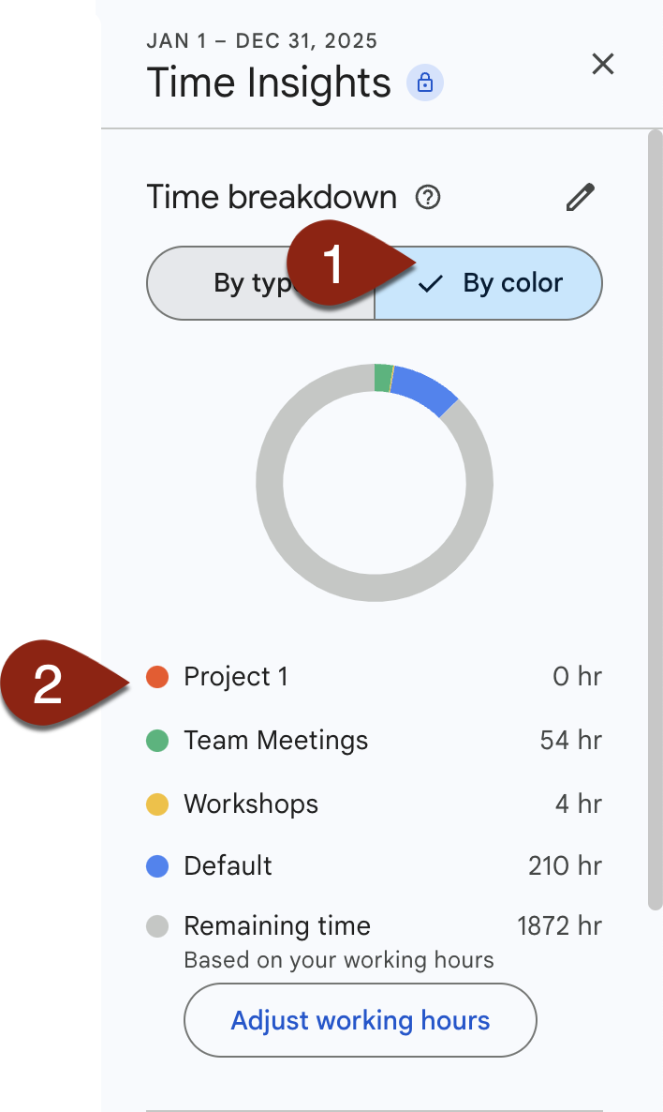
2. Code Your Calendar Events: Analyze Time Insights by Color
By Color
Near the top of Time Insights, click By color
See time breakdown by colors and labels you added previously Tip: The Remaining time breakdown is based on your set workings hour - Learn about working hours

Slide 18
2. Code Your Calendar Events: Use Time Insights Data
Time Insights Use Cases
Create a label for a project you’re working on and apply that label to related meetings or Focus time. Select a time period, then view Time Insights > By color to see how long you spent on that project.
In Time Insights > People you Meet with, pin the name of your mentee and use that tool to see duration of 1:1 meetings with your mentee
Use Time Insights > Time in meetings to see meeting patterns: What day has the most meetings; which month, etc.
Copy data from Time Insights into a spreadsheet to save, aggregate, or visualize

Slide 19
3. Track Project Time
Use a custom spreadsheet to track time on non-calendar projects

Slide 20
3. Track Project Time: Use a Spreadsheet to Enter Time
Enter non-calendar time in a spreadsheet
Make a copy of DEMO Project Time Tracking Tip: The spreadsheet has an Apps Script file to add timestamps
In Step 1: Enter Projects tab, enter the project(s) you want to track
In Step 2: Enter Job Duties tab, enter job duties you want to track
When working on a project, in Step 3: Enter Start/End Timestamps tab, click in Start Time column and click Insert Timestamp. Select the applicable Project and Job Duty Tip: Authorize the script by clicking Ok; then click Insert Timestamp again
When finished, in the same tab, select End Time column and click Insert Timestamp.
Repeat steps 4 and 5 when you work on that project

Slide 21
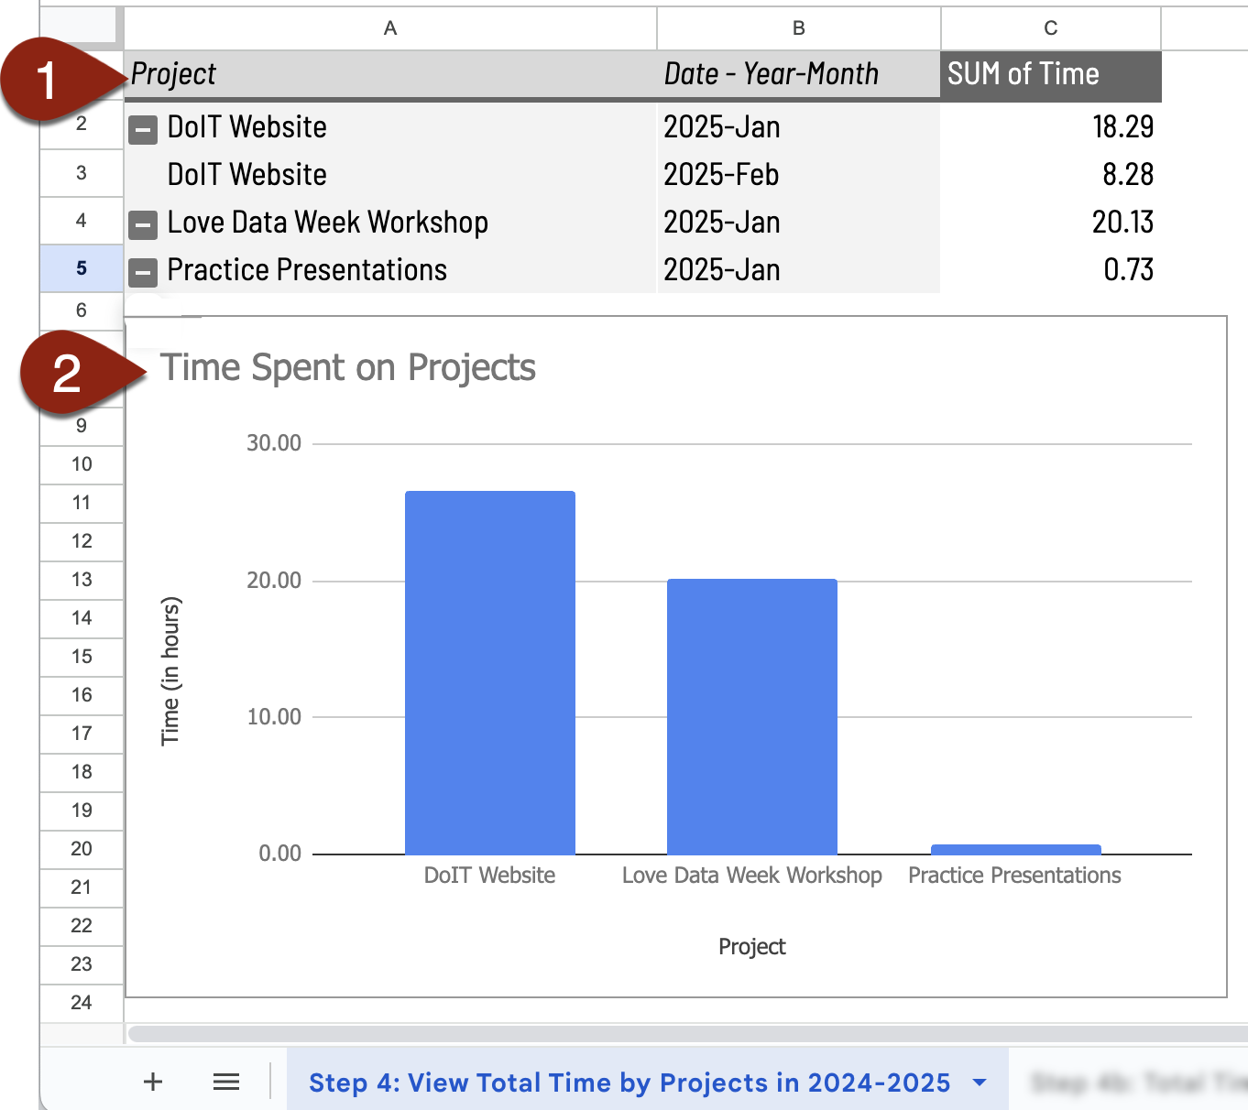
3. Track Project Time: Use a Spreadsheet Calculate Project Time
Calculate Project Time
In your copy of DEMO Project Time Tracking sheet, in the Step 4 tab you’ll see a pivot table showing total time by project and year-month
It also has a bar chart showing each project in the table and time spent
The other spreadsheet tabs have even more ways to look at your time

Slide 22
Resources
Gmail
Manage and create labels
Star emails
Google Calendar
Time Insights: View how you spend time in meetings
What counts toward Time Insights?
Use Focus Time
Set your working hours & location
Spreadsheet
EMPTY Project Time Tracking Sheet (make a copy to have your own)
Calculate project time with Pivot Tables
Visualize project time in a chart

Slide 23
Feedback
Was this helpful? Let me know!
02.14.25
SBU ❤️ Love Data Week 25
Uncover Your Impact: Organizing and Collecting Hidden Data to Tell Your Work Story

Slide 24
Contact
Julie Sharma
Division of Information Technology
Stony Brook University
631.632.9800 help.stonybrook.edu
it.stonybrook.edu/training
02.14.25
SBU ❤️ Love Data Week 25
Uncover Your Impact: Organizing and Collecting Hidden Data to Tell Your Work Story

